Slide 1

Chapter 12: Project Procurement Management
Information Technology Project Management, Eighth Edition

Slide 2
Importance of Project Procurement Management
Procurement means acquiring goods and/or services from an outside source
Other terms include purchasing and outsourcing
Experts predict that global spending on computer software and services will continue to grow
Garner estimated the value of the global IT industry in 2014 at $3.8 trillion
People continue to debate whether offshore outsourcing helps their own country or not

Slide 3
Debates on Outsourcing
Some companies, such as Wal-Mart, prefer to do no outsourcing at all, while others do a lot of outsourcing. GM recently announced plans to switch from outsourcing 90% of IT service to only 10%
Most organizations do some form of outsourcing to meet their IT needs and spend most money within their own country
The U.S. temporary workforce continues to grow as people work for temporary job agencies so they can more easily move from company to company

Slide 4
IT Outsourcing Market Continues to Grow
U.S. companies are transferring more work abroad, especially in the areas of IT infrastructure, application development and maintenance, and innovation processes
India, China, and the Philippines are the preferred locations for outsourcing, and Latin America is growing in popularity
A shortage of qualified personnel, not cost savings, is the top reason for global outsourcing of IT services

Slide 5
Why Outsource?
To access skills and technologies
To reduce both fixed and recurrent costs
To allow the client organization to focus on its core business
To provide flexibility
To increase accountability

Slide 6
Contracts
A contract is a mutually binding agreement that obligates the seller to provide the specified products or services and obligates the buyer to pay for them
Contracts can clarify responsibilities and sharpen focus on key deliverables of a project
Because contracts are legally binding, there is more accountability for delivering the work as stated in the contract

Slide 7
Project Procurement Management Processes
Project procurement management: Acquiring goods and services for a project from outside the performing organization
Processes include:
Planning procurement management: Determining what to procure and when and how to do it
Conducting procurements: Obtaining seller responses, selecting sellers, and awarding contracts
Controlling procurements: Managing relationships with sellers, monitoring contract performance, and making changes as needed
Closing procurements: Completing and settling each contract or agreement, including resolving of any open items

Slide 8
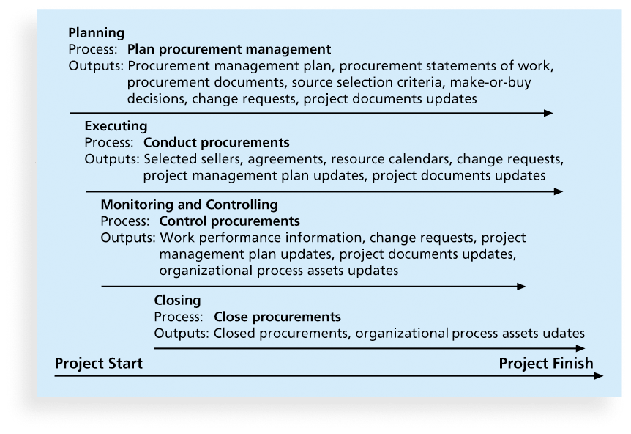
Figure 12-1. Project Procurement Management Summary

Slide 9
Planning Procurement Management
Identifying which project needs can best be met by using products or services outside the organization
If there is no need to buy any products or services from outside the organization, then there is no need to perform any of the other procurement management processes

Slide 10
Types of Contracts
Different types of contracts can be used in different situations:
Fixed price or lump sum contracts: Involve a fixed total price for a well-defined product or service
Cost reimbursable contracts: Involve payment to the seller for direct and indirect costs
Time and material contracts: Hybrid of both fixed price and cost reimbursable contracts, often used by consultants
Unit price contracts: Require the buyer to pay the seller a predetermined amount per unit of service
A single contract can actually include all four of these categories, if it makes sense for that particular procurement

Slide 11
Point of Total Assumption
The Point of Total Assumption (PTA) is the cost at which the contractor assumes total responsibility for each additional dollar of contract cost
Contractors do not want to reach the point of total assumption, because it hurts them financially, so they have an incentive to prevent cost overruns
The PTA is calculated with the following formula:
PTA = (ceiling price – target price)/government share + target cost

Slide 12
Cost Reimbursable Contracts
Cost plus incentive fee (CPIF): The buyer pays the supplier for allowable performance costs plus a predetermined fee and an incentive bonus
Cost plus fixed fee (CPFF): The buyer pays the supplier for allowable performance costs plus a fixed fee payment usually based on a percentage of estimated costs
Cost plus percentage of costs (CPPC): The buyer pays the supplier for allowable performance costs plus a predetermined percentage based on total costs

Slide 13
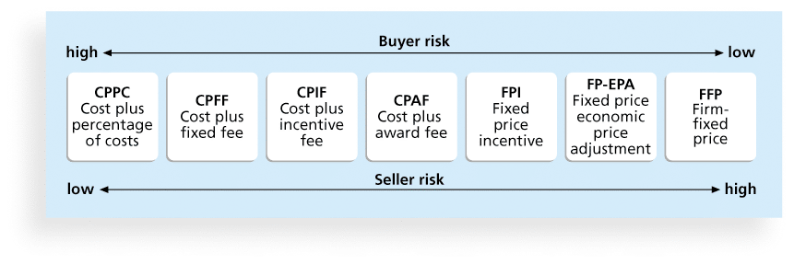
Figure 12-2. Contract Types Versus Risk

Slide 14
Tools and Techniques for Planning Purchases and Acquisitions
Expert judgment
Market research
Make-or-buy analysis: General management technique used to determine whether an organization should make or perform a particular product or service inside the organization or buy from someone else

Slide 15
Make-or-Buy Example
Assume you can lease an item you need for a project for $800/day. To purchase the item, the cost is $12,000 plus a daily operational cost of $400/day
How long will it take for the purchase cost to be the same as the lease cost?

Slide 16
Make-or Buy Solution
Set up an equation so both options, purchase and lease, are equal
In this example, use the following equation. Let d be the number of days to use the item:
$12,000 + $400d = $800d
Subtracting $400d from both sides, you get:
$12,000 = $400d
Dividing both sides by $400, you get:
d = 30
If you need the item for more than 30 days, it is more economical to purchase it

Slide 17
Procurement Management Plan
Describes how the procurement processes will be managed, from developing documentation for making outside purchases or acquisitions to contract closure
Contents varies based on project needs

Slide 18
Contract Statement of Work (SOW)
A statement of work is a description of the work required for the procurement
If a SOW is used as part of a contract to describe only the work required for that particular contract, it is called a contract statement of work
A SOW is a type of scope statement
A good SOW gives bidders a better understanding of the buyer’s expectations

Slide 19
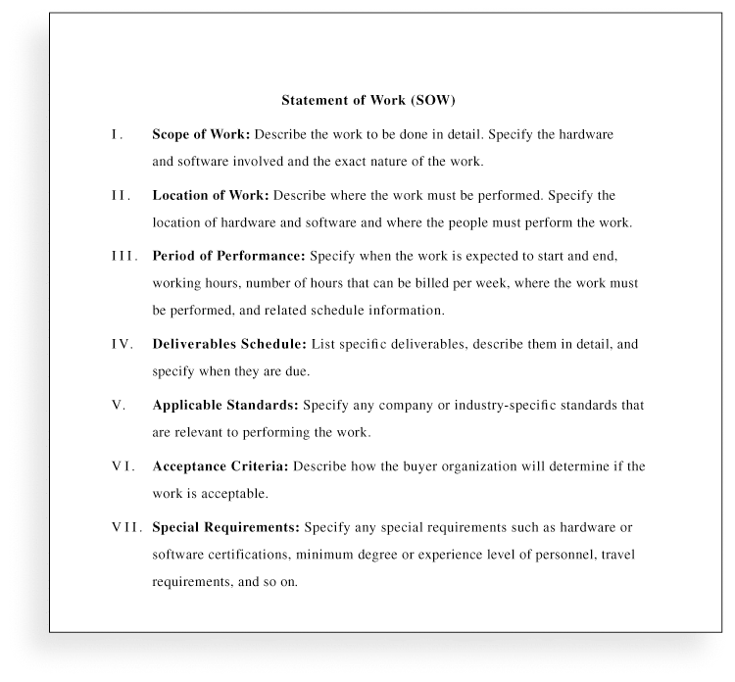
Figure 12-3. Statement of Work (SOW) Template

Slide 20
Procurement Documents
Request for Proposals: Used to solicit proposals from prospective sellers
A proposal is a document prepared by a seller when there are different approaches for meeting buyer needs
Requests for Quotes: Used to solicit quotes or bids from prospective suppliers
A bid, also called a tender or quote (short for quotation), is a document prepared by sellers providing pricing for standard items that have been clearly defined by the buyer

Slide 21
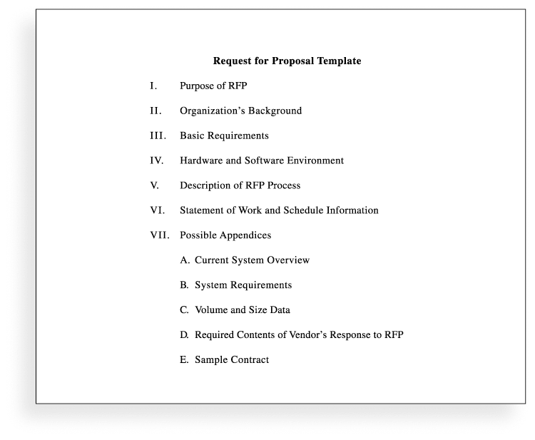
Figure 12-4. Request for Proposal (RFP) Template

Slide 22
Source Selection Criteria
It’s important to prepare some form of evaluation criteria, preferably before issuing a formal RFP or RFQ
Beware of proposals that look good on paper; be sure to evaluate factors, such as past performance and management approach
Can require a technical presentation as part of a proposal

Slide 23
Conducting Procurements
Deciding whom to ask to do the work
Sending appropriate documentation to potential
sellers
Obtaining proposals or bids
Selecting a seller
Awarding a contract

Slide 24
Approaches for Procurement
Organizations can advertise to procure goods and services in several ways:
Approaching the preferred vendor
Approaching several potential vendors
Advertising to anyone interested
A bidders’ conference can help clarify the buyer’s expectations

Slide 25
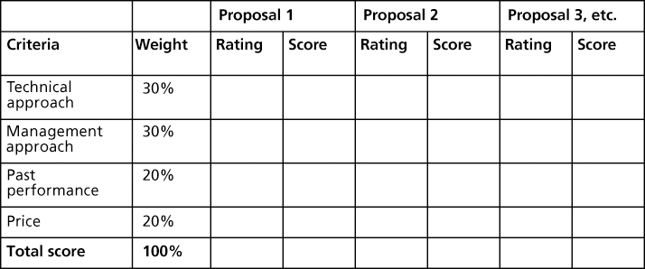
Figure 12-5. Sample Proposal Evaluation Sheet

Slide 26
Seller Selection
Organizations often do an initial evaluation of all proposals and bids and then develop a short list of potential sellers for further evaluation
Sellers on the short list often prepare a best and final offer (BAFO)
Final output is a contract signed by the buyer and the selected seller

Slide 27
Controlling Procurements
Ensures that the seller’s performance meets contractual requirements
Contracts are legal relationships, so it is important that legal and contracting professionals be involved in writing and administering contracts
It is critical that project managers and team members watch for constructive change orders, which are oral or written acts or omissions by someone with actual or apparent authority that can be construed to have the same effect as a written change order

Slide 28
Closing Procurements
Involves completing and settling contracts and resolving any open items
The project team should:
Determine if all work was completed correctly and satisfactorily
Update records to reflect final results
Archive information for future use
The contract itself should include requirements for formal acceptance and closure

Slide 29
Chapter Summary
Project procurement management involves acquiring goods and services for a project from outside the performing organization
Processes include:
Plan procurement management
Conduct procurements
Control procurements
Close procurements

